Slide 1

Retail Shop Database Project Report
Name: Aqsa Essa
Section: Sec 4

Slide 2

Introduction
The goal of this project is to analyse the dataset of an online retail shop to generate valuable business insights. The dataset contains various attributes like invoice numbers, customer information, product details, and transaction amounts. By running multiple SQL queries, we aim to extract useful information such as purchase patterns, customer behaviour, product affinity, and sales trends.

Slide 3

Schema Setup
The retailshop schema was created, followed by selecting the working database using the USE retailshop; command.
A metadata table was also created to maintain information about the columns and their respective data types. T
His metadata helps us understand the structure of the online_retail table better.

Slide 4
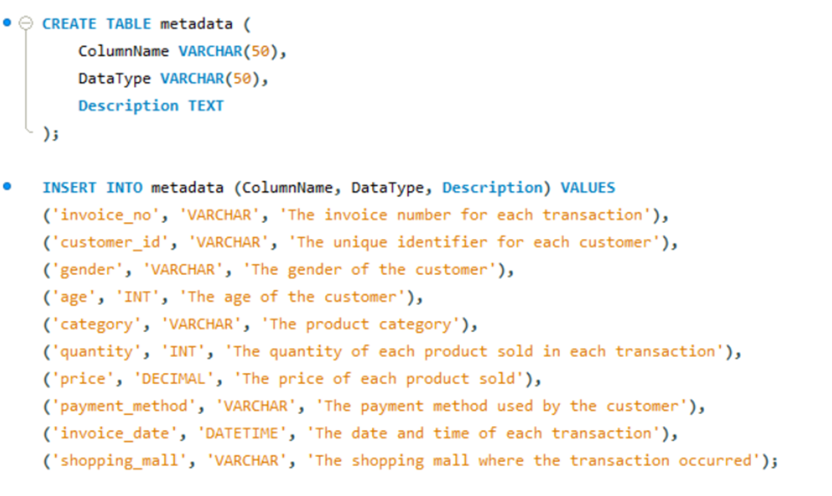

Slide 5
Query Execution and Results
Distribution of Order Values Across All Customers
This query calculates the total value of purchases made by each customer and orders the result in descending order to identify the highest spending customers.
The query calculates the total value of all purchases by multiplying the Quantity and UnitPrice for each transaction and grouping them by CustomerID.

Slide 6
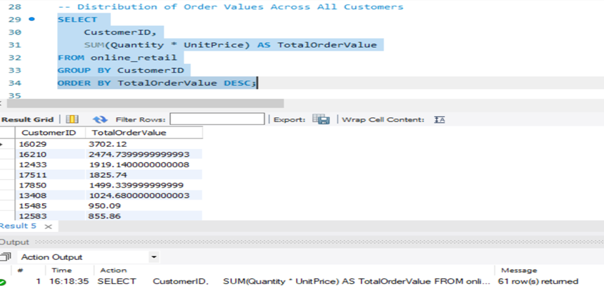

Slide 7
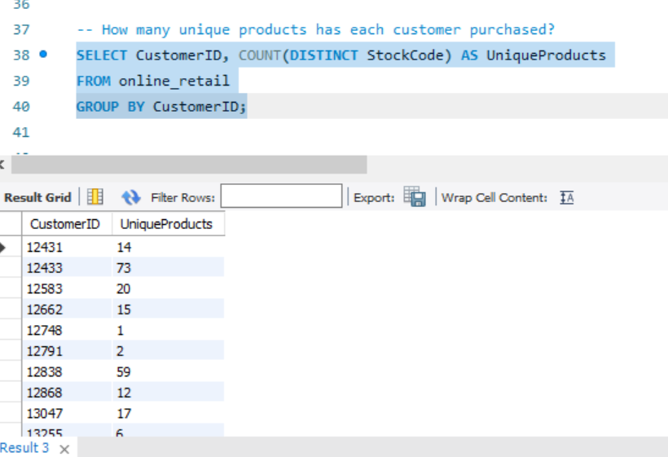
Unique Products Purchased by Each Customer
This query identifies customers who have only made one unique purchase.
The HAVING clause filters out customers who have made multiple purchases, providing insight into one-time buyers.

Slide 8
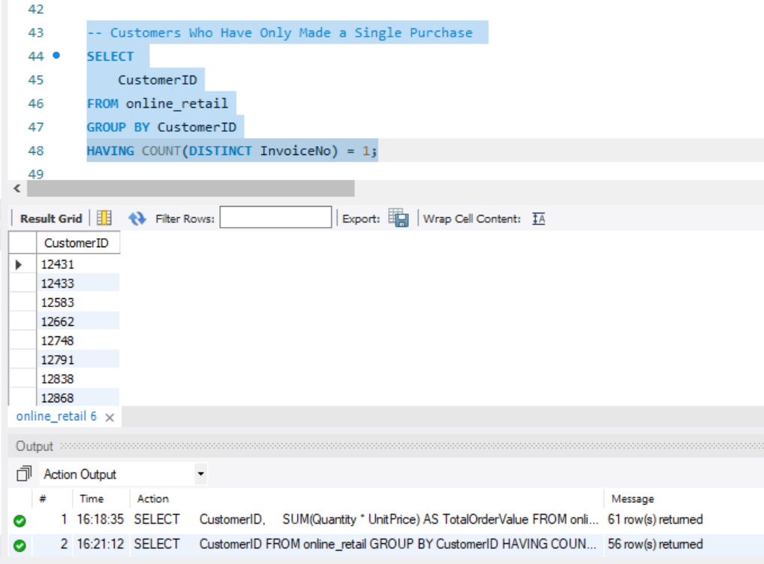
Customers Who Have Made a Single Purchase
The query retrieves customers who have made only a single purchase based on the InvoiceNo field.

Slide 9
Most Commonly Purchased Products Together
This query analyzes the products frequently purchased together by joining the same InvoiceNo and then counting product pairs.
The results show the top 10 product pairs most commonly purchased together, giving insights into product affinity and cross-selling opportunities.

Slide 10
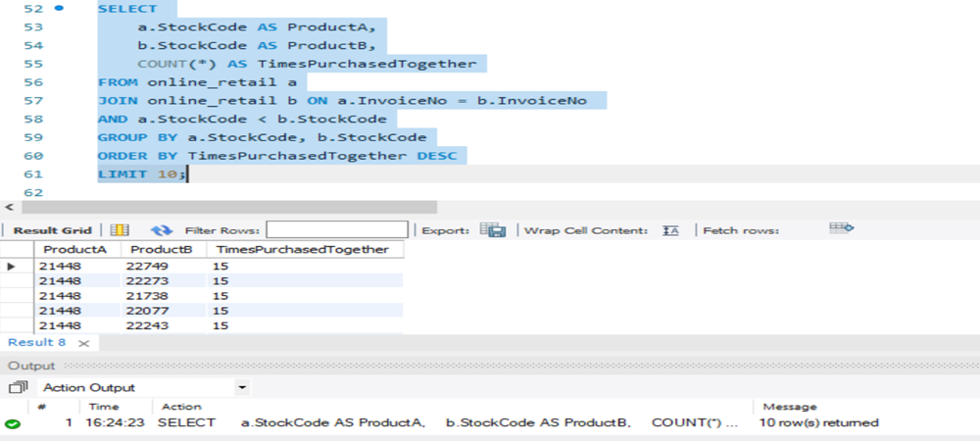

Slide 11
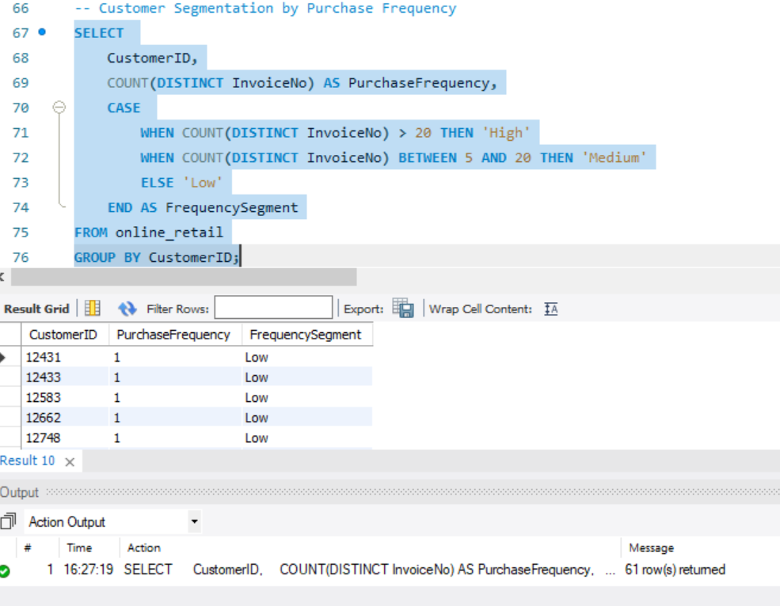
Customer Segmentation by Purchase Frequency
Customers are segmented based on the number of purchases they have made, which is useful for targeted marketing.
The CASE statement categorizes customers into high, medium, and low-frequency segments.

Slide 12
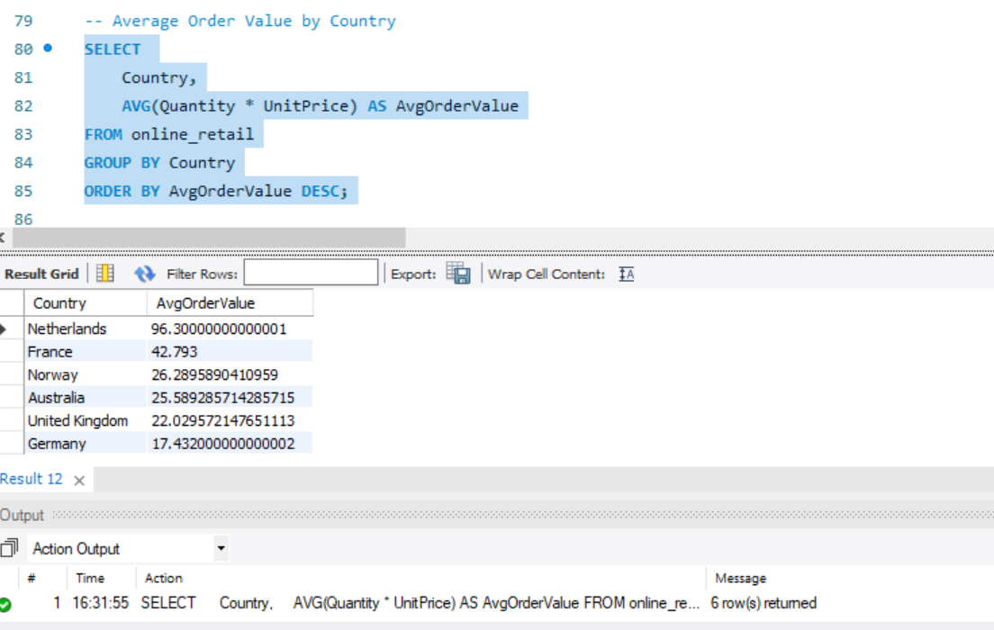
Average Order Value by Country
This query calculates the average order value across different countries to understand where higher-value purchases are occurring.

Slide 13
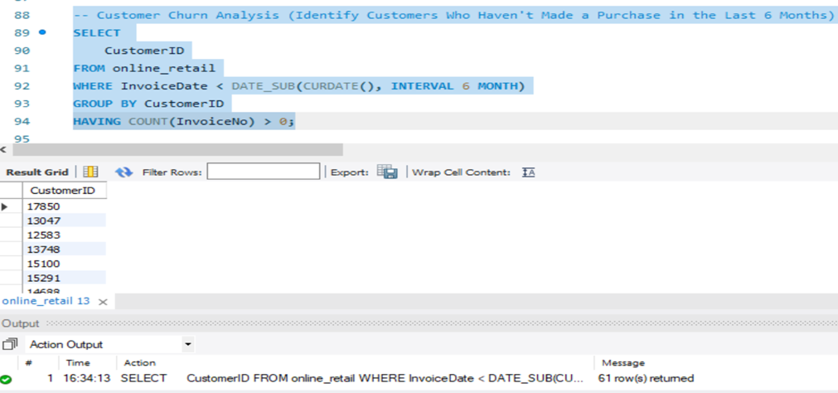
Customer Churn Analysis
Identifying customers who haven’t purchased in the last six months is crucial for a churn analysis, helping to devise retention strategies.

Slide 14
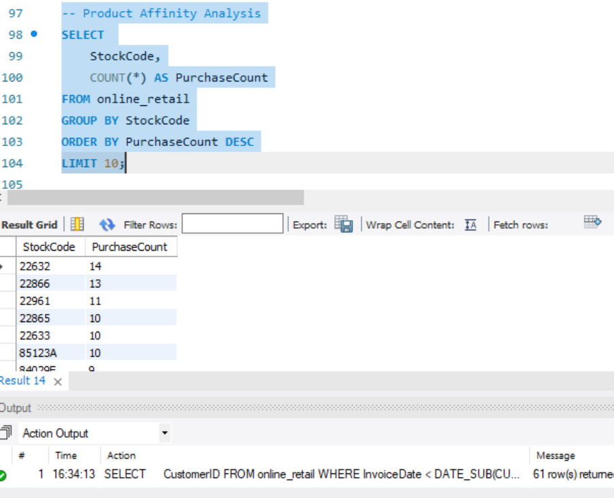
Product Affinity Analysis
This query helps identify the most popular products based on the number of purchases.

Slide 15
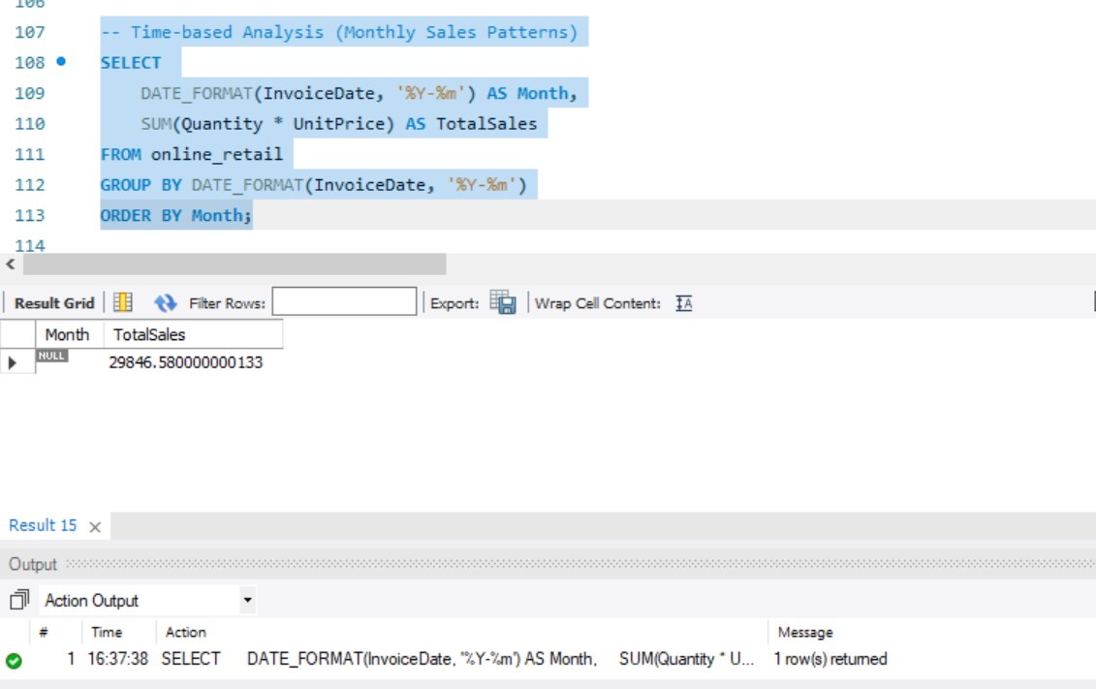
Time-Based Analysis (Monthly Sales Patterns)
To identify sales trends over time, this query summarizes sales every month.
This query provides insights into sales performance monthly, which can help in forecasting and identifying seasonality.

Slide 16
Conclusion
This project provided key insights into customer behavior, product trends, and sales patterns using SQL queries on the online_retail dataset.
We identified high-spending customers, common product pairings, and segmented customers by purchase frequency.
Monthly sales trends offered a clear view of peak periods, while churn analysis revealed opportunities for customer retention.
These insights can help improve marketing strategies, product offerings, and overall business performance. Going forward, deeper analytics can further enhance decision-making and customer engagement strategies.
GitHub Profile: https://github.com/AqsaEssa

